Slide 1
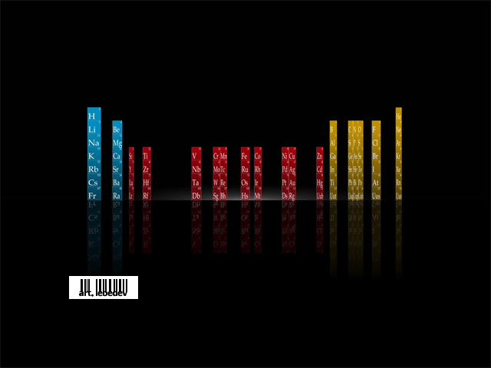

Slide 2
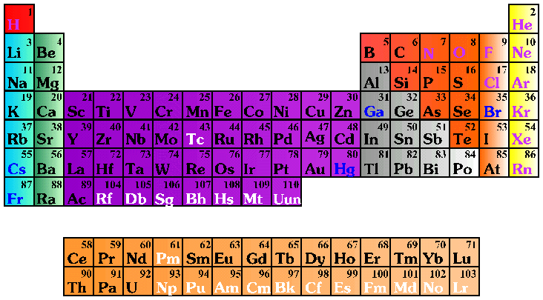
THE Periodic Table
Solid Liquid Gas Synthetic
Alkali Metals Alkali Earth Metals Transition Metals Rare Earth Metals
Other Metals Noble Gases Halogens Other Nonmetals

Slide 3
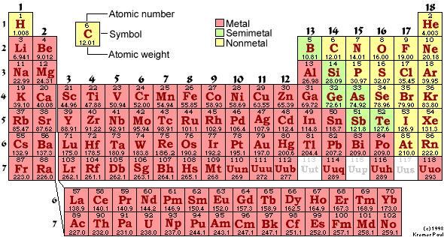

Slide 4
http://lectureonline.cl.msu.edu/~mmp/period/phase.htm
Melting points/phases Periodic table Link

Slide 5
http://www.webelements.com/
Element information and pics

Slide 6
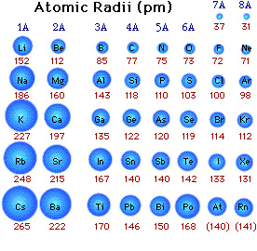

Slide 7
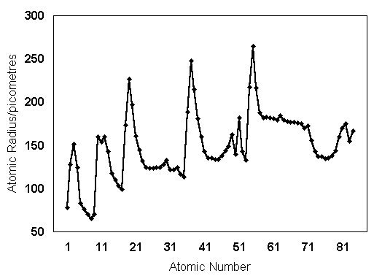
Atomic radii vs atomic number

Slide 8
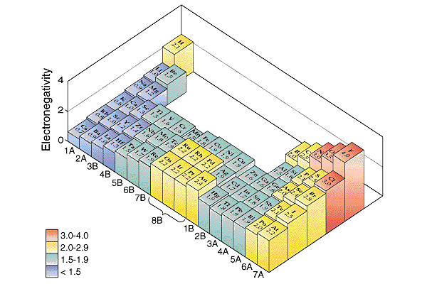
Electronegativity & THE Periodic Table

Slide 9
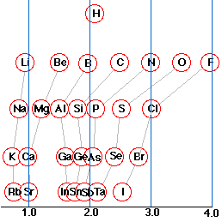
Group trends in electronegativity
Electronegativity

Slide 10
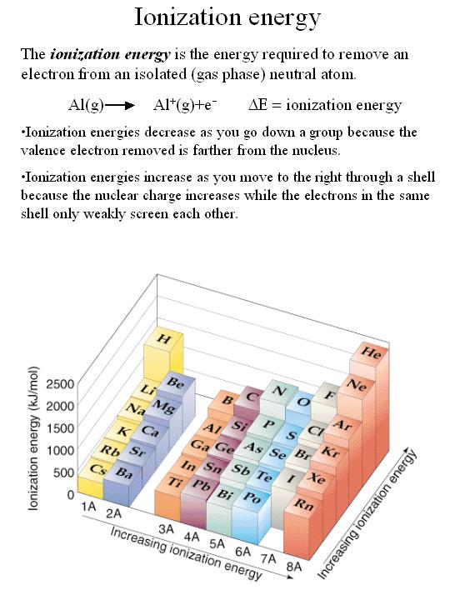
Ionisation energy & THE Periodic Table

Slide 11
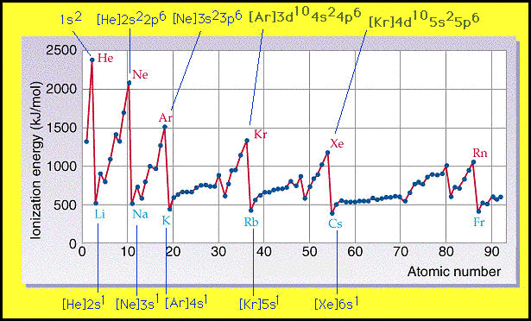
Ionisation energy vs atomic number

Slide 12
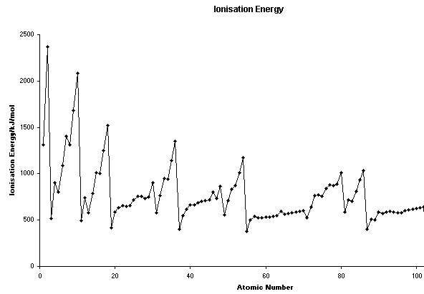
Ionisation energy vs atomic number

Slide 13
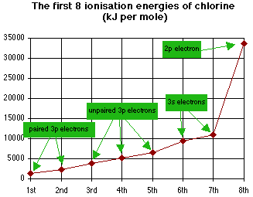
Challenge Question : Why is there such a large jump in energy for the removal of the 8th electron?

Slide 14
Answer : Chlorine, being a halogen gas (group VII) has 7 outer electrons. Once these 7 have been removed chlorines outer shell is empty and it now has a noble gas configuration (neon). The eighth electron to be removed would come form the full n = 2 energy level and hence is much more difficult to remove.

Slide 15
http://education.jlab.org/itselemental/
Periodic table with propoerties

Slide 16
Periodic Table of the Elements
Source: © 1996 Lawrence Berkeley National Laboratory
Parentheses indicate undiscovered elements.

